Slide 1

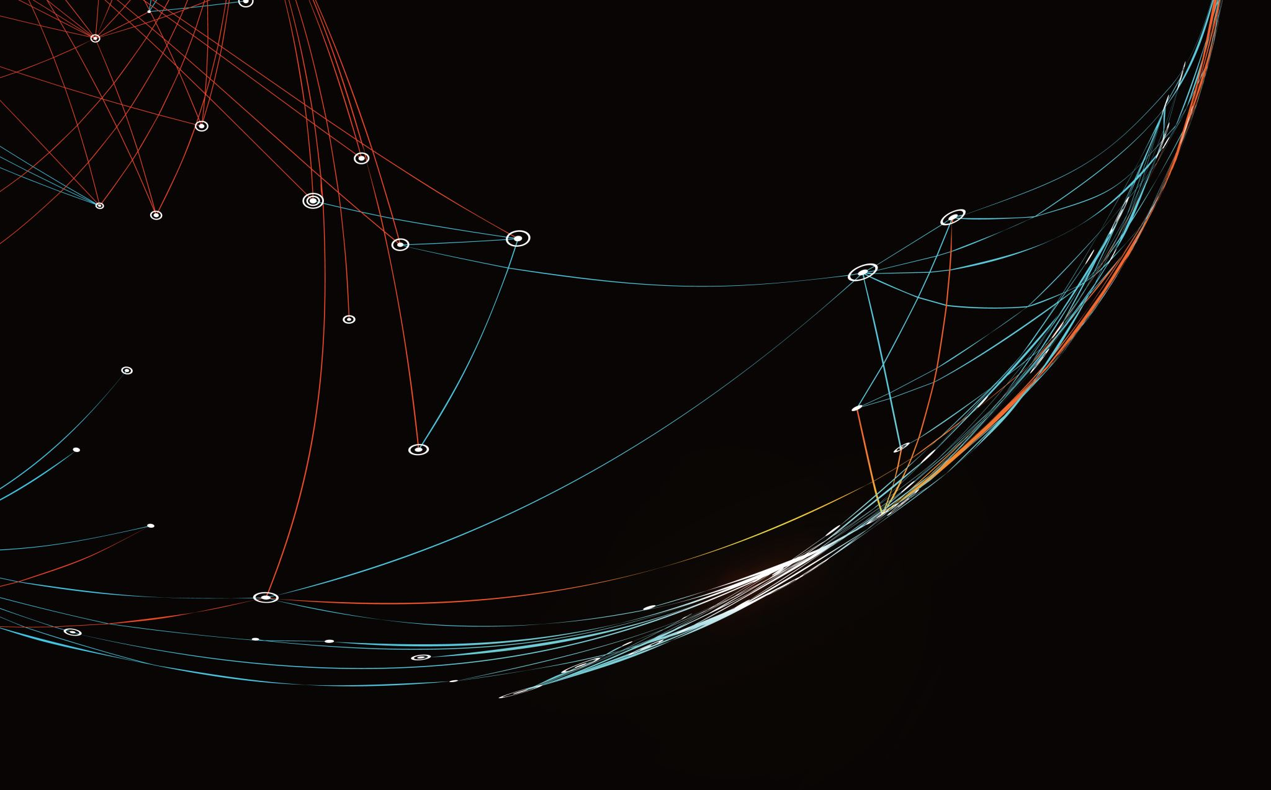

Credit Card Fraud Detection: Capstone Project (BI/DA)
Syed Murtuza Ali

Slide 2

AGENDA
Problem Statement
Objective
Key Findings
Summary of model evaluation
Cost analysis

Slide 3
Problem Statement
Data Understanding
This is a simulated data set taken from the Kaggle website and contains both legitimate and fraudulent transactions
The data set contains credit card transactions of around 1,000 cardholders with a pool of 800 merchants from 1 Jan 2019 to 31 Dec 2020. It contains a total of 18,52,394 transactions, out of which 9,651 are fraudulent transactions. The data set is highly imbalanced, with the positive class (frauds) accounting for 0.52% of the total transactions. Now, since the data set is highly imbalanced, it needs to be handled before model building. The feature 'amt' represents the transaction amount. The feature 'is_fraud' represents class labelling and takes the value 1 the transaction is a fraudulent transaction and 0, otherwise.

Slide 4
Objective
Reduce time-consuming manual reviews, costly chargebacks and fees, and denial of legitimate transactions.
Recommend the optimal ways that the bank can adopt to mitigate the fraud risks.

Slide 5
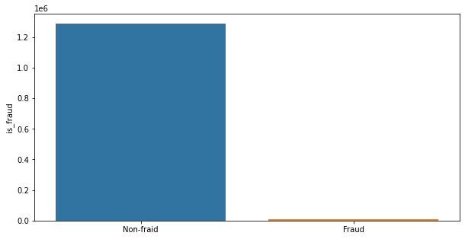
Key Findings
The dataset contains 12,89,169 of non-fraud cases and 7,506 of fraud cases the ratio to fraud and non-fraud is 0.58 %

Slide 6
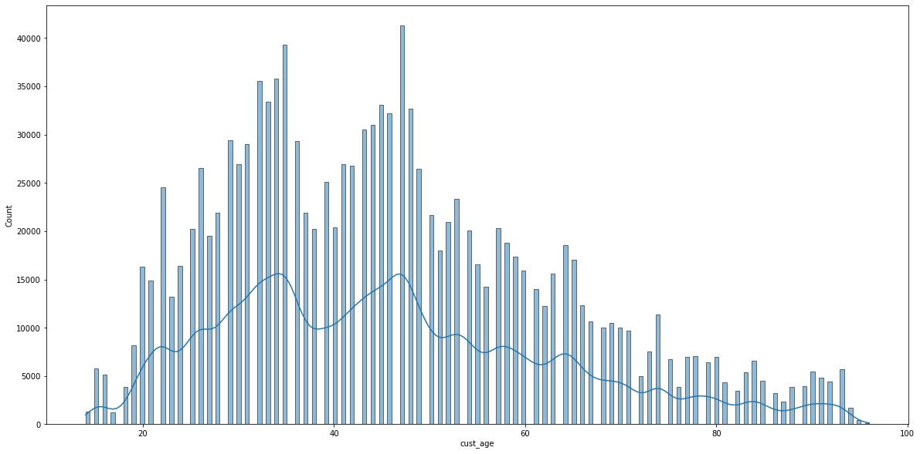
People between the age 25 - 50 do more transactions, the data has no outliers all the people are under 90yrs of age

Slide 7

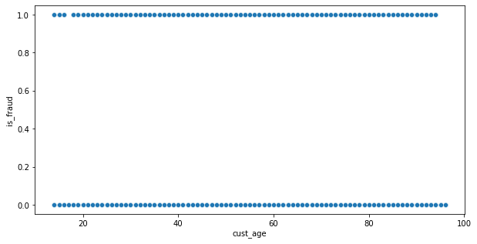
Frauds are happening in all the age groups

Slide 8
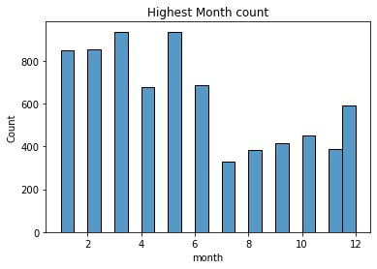
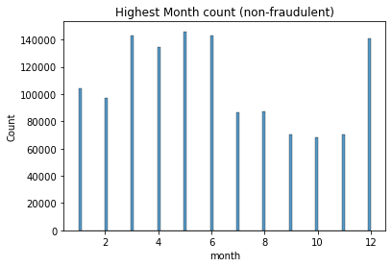

Slide 9
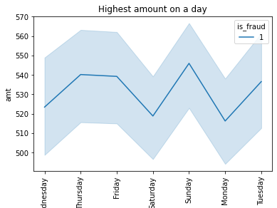
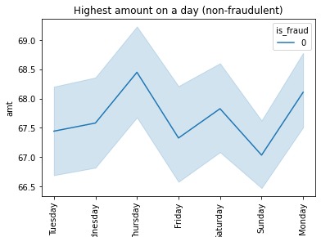

Slide 10
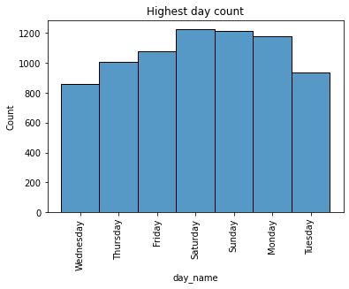
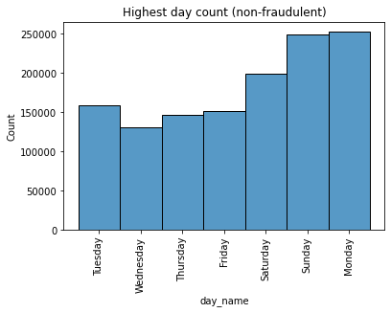

Slide 11
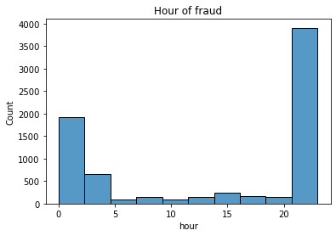
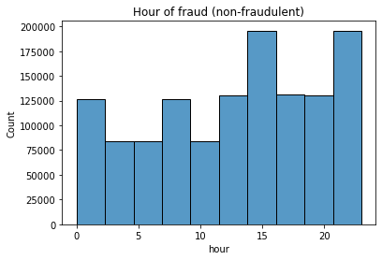

Slide 12
Observation
the dataset has the more number of transactions in April to July and December month. it is also observed that despite December being the highest the fraudulent transactions are very less init.
For some reason, the fraudulent transactions are more in the 1st and 2nd quarter of the year than it drops drastically.
for some reason, On Sunday transactions occurs on less amount of money, and also on this day, the maximum money has been stolen the following Tuesday and Thursday.
More transactions occur on Sunday, Monday, and Tuesday and it gets lesser on other days and most of the fraudulent transactions happen on weekends.
The number of transactions increases from morning to evening but most of the fraudulent ones happen at night time between 10:00 PM to 2:30 AM.
Conclusion:
More frauds happen in 1st half of the year, it happens on weekends in the night hours.

Slide 13
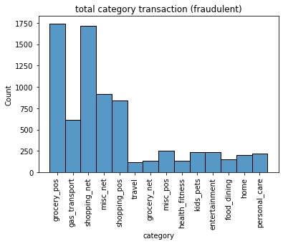
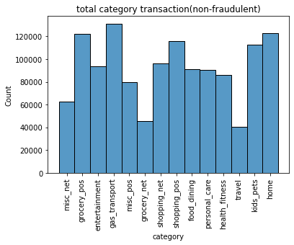

Slide 14
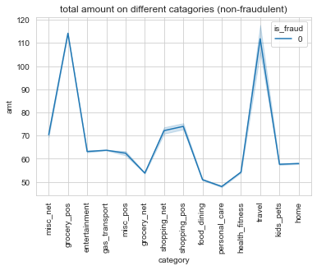
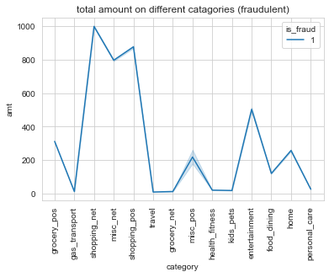

Slide 15
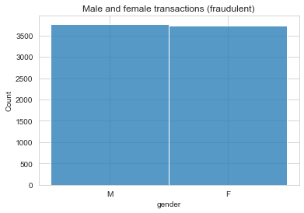
Observations:
Fraudulent transactions in the categories are seen the most in shopping_net, groceries_pos, mics_net, and shopping_pos.
The amount spent on non-fraudulent transactions is maximum in travel and groceries_pos but in the case of fraudulent transactions shopping_net, mics_net, shopping_pos, and entertainment.
It appears fraud can happen to both females and males almost the same number of times, but it happens to males slightly more.
Conclusion:
More frauds happen more frequently where shopping is involved of local products.

Slide 16
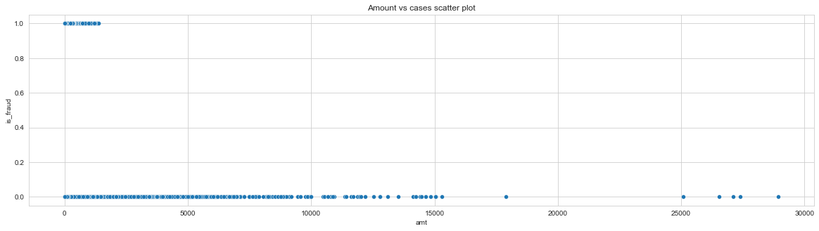

Slide 17
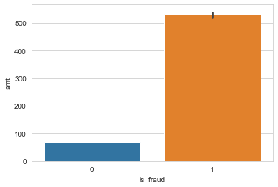
Out of total amount 9,12,22,428.9 $, 39,88,088.61 $ has been fraudulent and i.e 4.0% of total

Slide 18
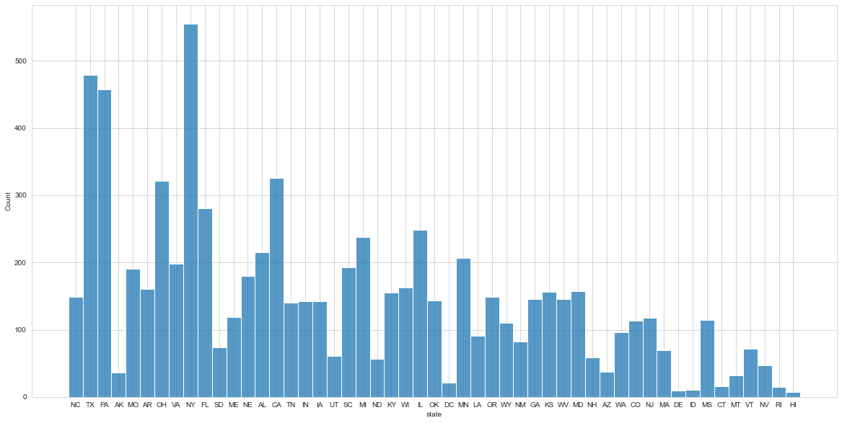
highest frauds in states
NY 555
TX 479
PA 458
CA 326
OH 321
----------------------------------------
lowest frauds in states
HI 7
DE 9
ID 11
RI 15
CT 16

Slide 19
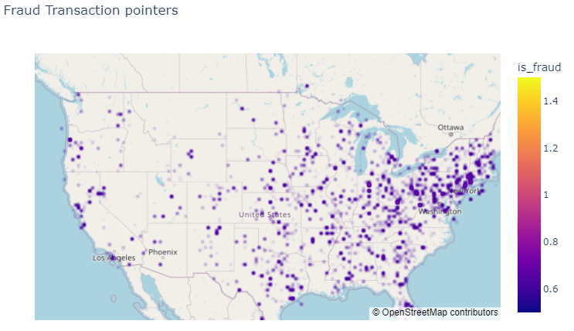
Observation: some cities like Camden, Birmingham, Burroton ..etc have the highest cases of fraud. The least fraud areas are near Laramie, Sherman, Littleton, etc. The highest fraud is in NY, PA, TX, etc., and the least are CO, WY, HI, etc. Conclusion: It appears the Western region of the map is more populated and so the fraudulent activities are also more in those regions.

Slide 20
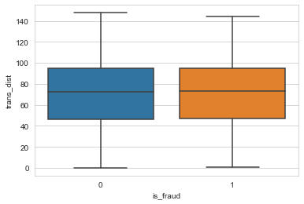
both fraud and non-fraudulent transactions are happening approximately within 140kms from the home of a customer

Slide 21

Summary of the models evaluated
In this file, I have considered the Decision tree model, XGboost model, and Logistic regression model and for the sampling techniques, I used SMOTE and ADASYN.
Although I have tested the model without it and noted the results, so this makes 9 models.
Out of these 9 models, the model which gave me the perfect score was XGboost with ADASYN as its sampling technique, the score is as follows.
- accuracy - 0.97
- recall -0.94
- f1 -0.25
for training data
- accuracy - 0.96
- recall -0.87
- f1 -0.22
for test data
Here, we have focused on getting maximum recall in order to detect actual fraudulent transactions in order to save the banks from high-value fraudulent transactions.

Slide 22

Tested the model on unseen data that model has never seen
My best model was XGBoost with ADASYN as its sampling technique.
Recall Score – 0.987
Confusion Matrix
[[543921 9653]
[ 6967 546465]]

Slide 23
Cost-Benefit Analysis
Part – 1
Average number of transactions per month 2020 is 77295.33, 2019 is 77070.83 and on total dataset is 77183.08
Average number of fraudulent transactions per month for 2020 is 369.25 and 2019 is 435.0 and on total dataset is 402.125.
Average amount per fraudulent transaction for 2020 is 531.16 and 2019 is 530.23 and on total dataset is 530.66

Slide 24
Cost-Benefit Analysis
Part – 2
Cost incurred per month before the model was deployed 213,391.65 $.
Total cost of providing customer support per month for fraudulent transactions detected by the model 21,744.10 $.
Cost incurred due to these fraudulent transactions left undetected by the model 58.39 $.
Therefore, the cost incurred per month after the model is built and deployed 60.65 $.
Final savings are : 213,331.0 $

Slide 25
Thank you

